Slide 1


MATLAB & Simulink workshop
Made by: Youssef Ahmed

Slide 2

Session 7
Modeling with Simulink

Slide 3


Last session recap

Slide 4
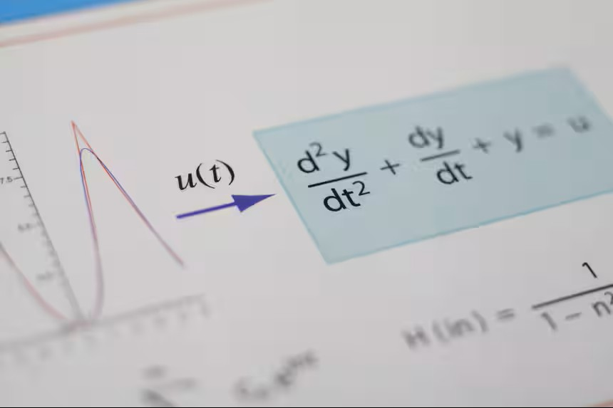
Modeling With Simulink
Differential equations are the language of the universe!

Slide 5
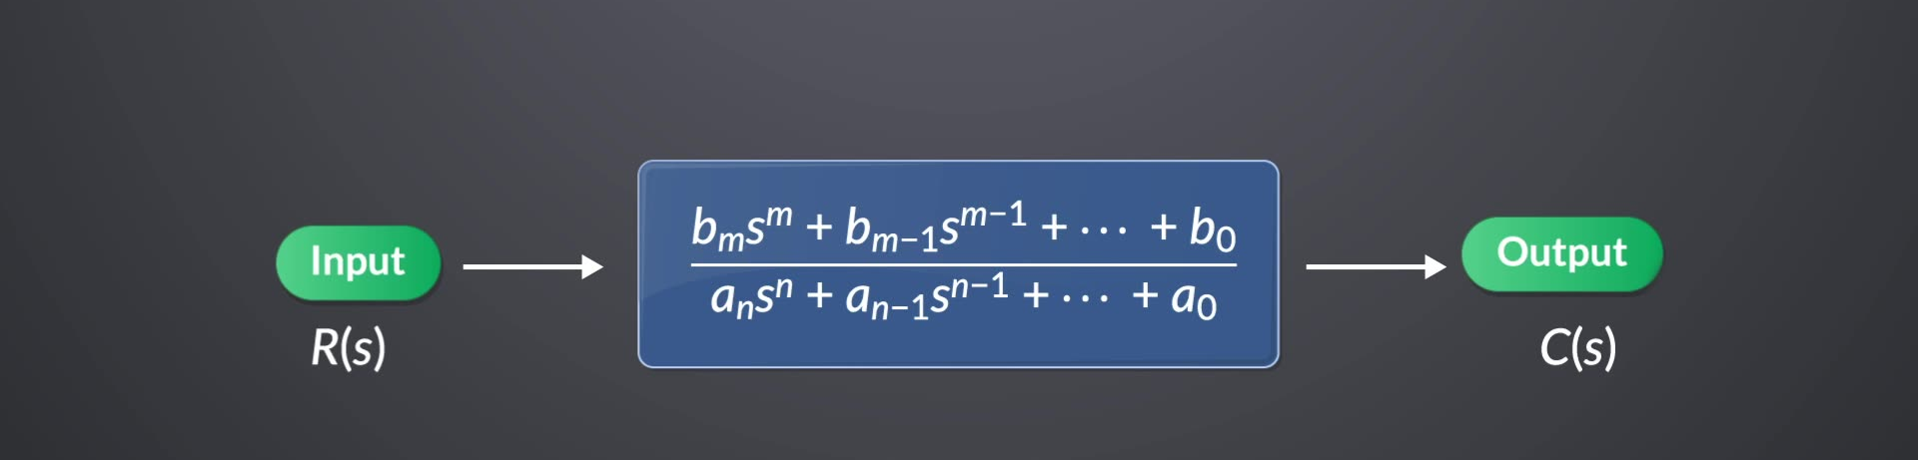
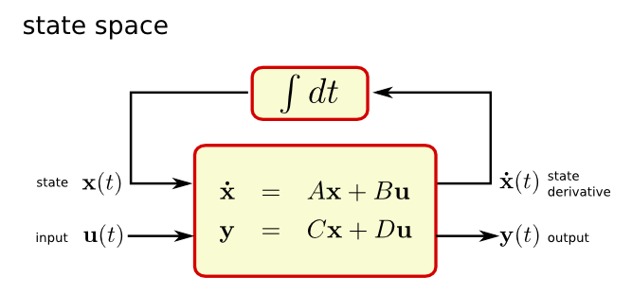
Modeling With Simulink
Differential equations are not the only way!
State-space representation
Transfer function

Slide 6
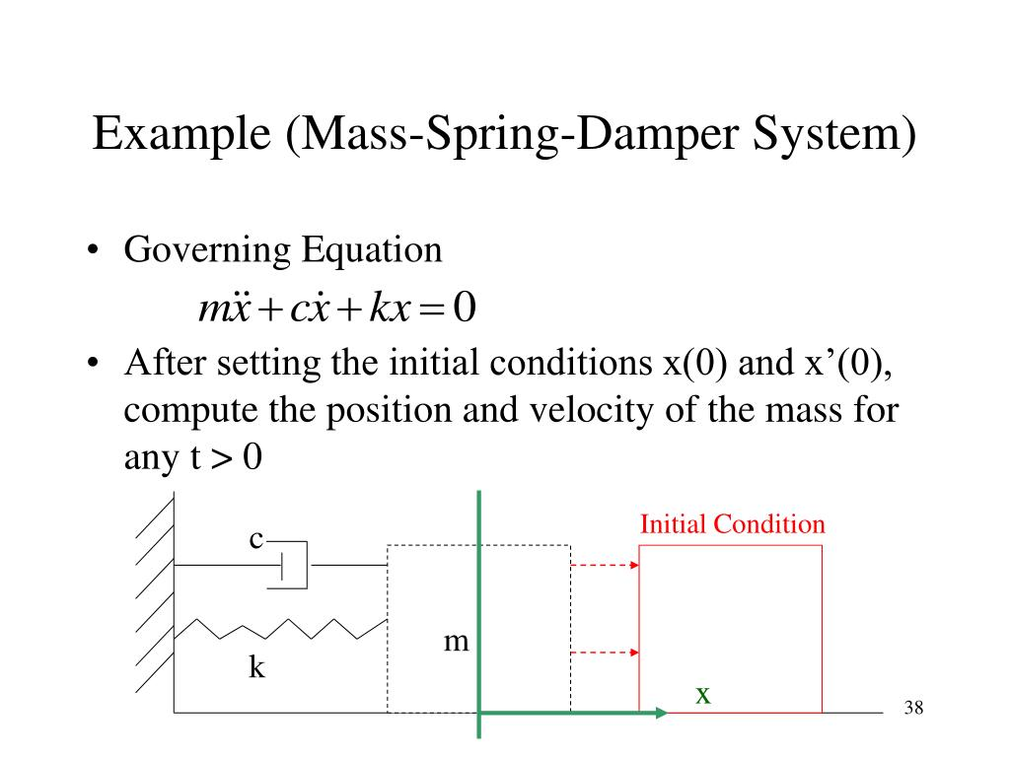
Modeling With Simulink
Modeling of ODEs

Slide 7
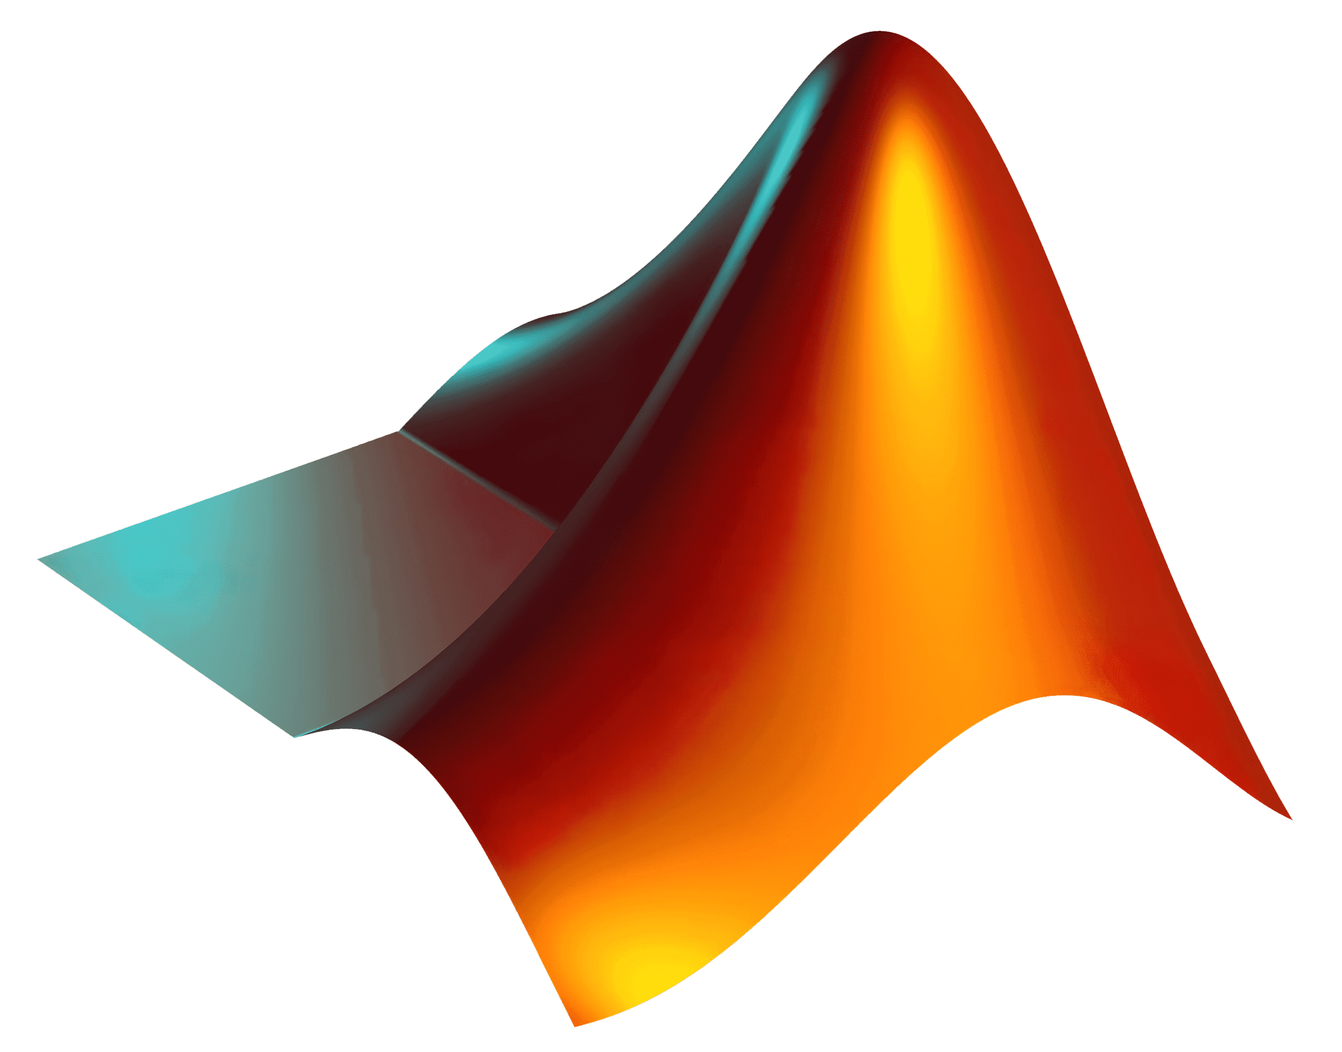
MATLAB time!
Now let’s see what we covered so far in MATLAB

Slide 8

Simulink
Simulink & MATLAB communication

Slide 9
MATLAB time!
Now let’s see what we covered so far in MATLAB

Slide 10
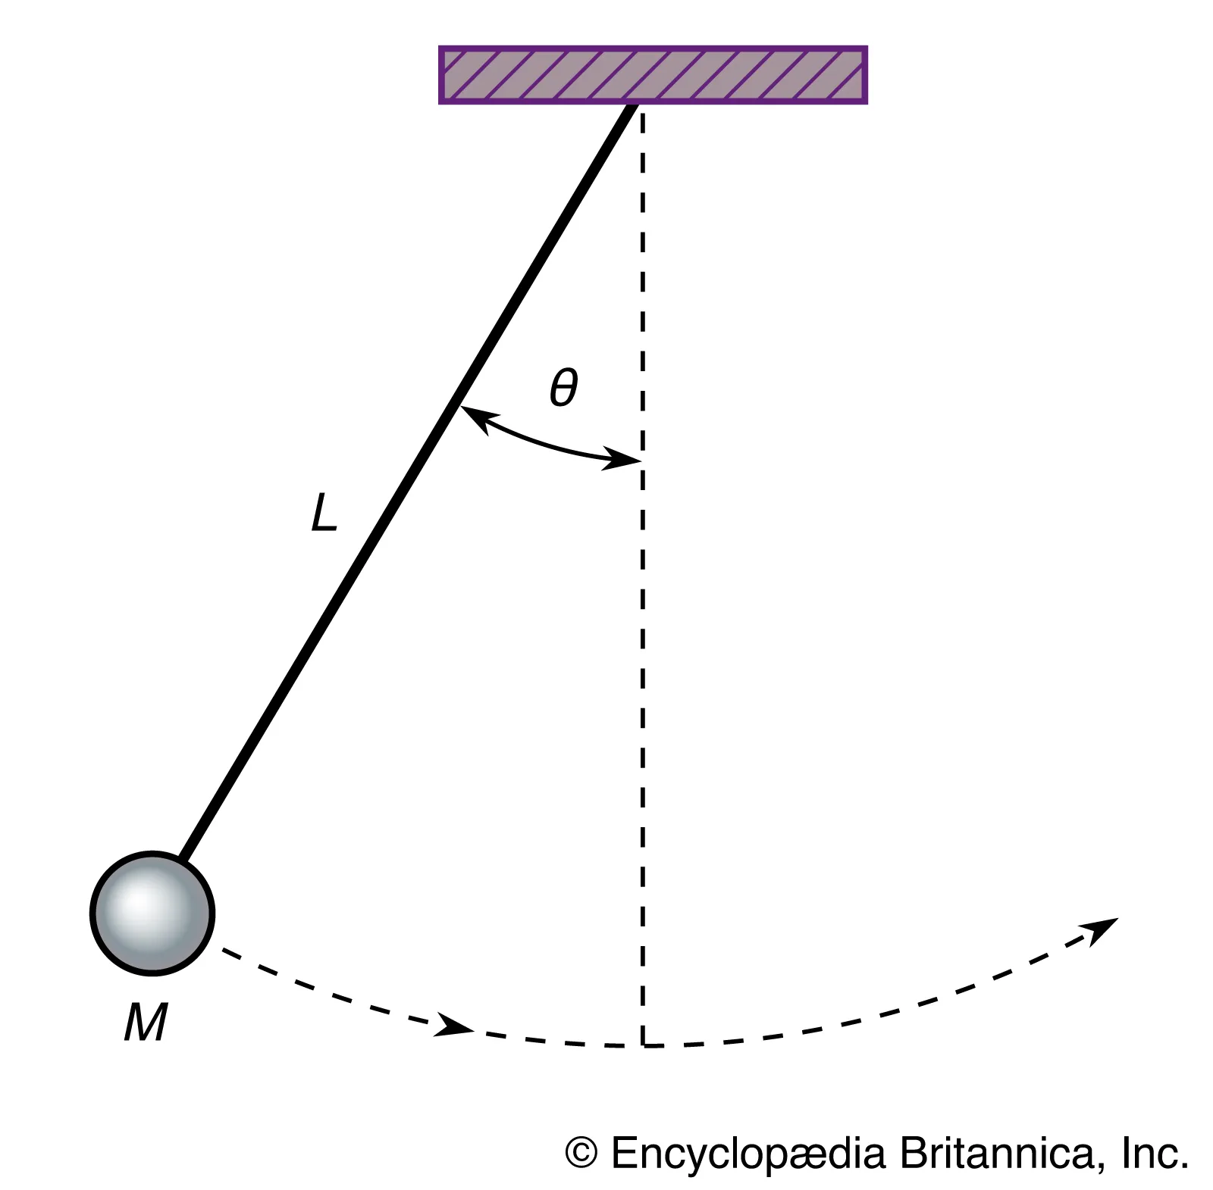
Task
1-Overview
You are required to model a pendulum system with air resistance then compute the energy of the system, then calculate the time it takes for the pendulum to lose 90% of its energy.

Slide 11

Task
2-Pendelum model
The system can be modeled with the following differential equation: $$ML^{2}\ddot{θ}+\frac{1}{2}ρC_{d}AL^{3}\dot{θ}\left|\dot{θ}\right|+MgL\sin{θ}=0$$
Where: M: mass of the sphere = 0.5 Kg
L: length of the wire = 1 m
$ρ$: density of air = 1.225
$C_{d}$: drag (damping coefficient) = 0.47
A: area of the sphere = 0.00785
$g$: gravity constant = 9.81
$θ:$ angle of the pendulum
$$θ\left(0\right)=\frac{π}{2}$$
$$\dot{θ}\left(0\right)=0$$

Slide 12

Task
3-Energy calculation
After modeling the system, you are required to use the signals from the model to use it to calculate the energy of the system.
The energy of the system can be calculated by the sum of kinetic energy and potential energy given by the flowing equations $$P.E=MgL\left(1−\cos{θ}\right)$$
$$K.E=\frac{1}{2}ML^{2}{\dot{θ}}^{2}$$
Notice that you are free to choose if you want to calculate it in Simulink or MATLAB

Slide 13
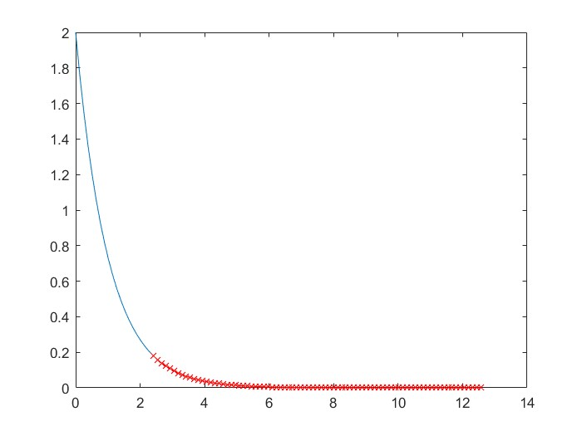
Task
4-Postprocessing
The next step is to export relevant data to MATLAB workspace to calculate the time required for the system to lose 90% of its energy, then store it as a variable called “decayTime”
Another required step is to plot the energy graph in MATLAB with the part below 90% energy with different as shown in example

Slide 14
Task
5-Deliverables
You are required to submit the following:
Screenshot of the model
The MATLAB script (.m or .mlx file) used for parameters definition and post processing
Screenshot of the post processing plot (mentioned in step 4)
The Simulink model (.slx file)

Slide 15
Thank you!

